Slide 1
Digital Twin Model: Line Boring Machine

Slide 2
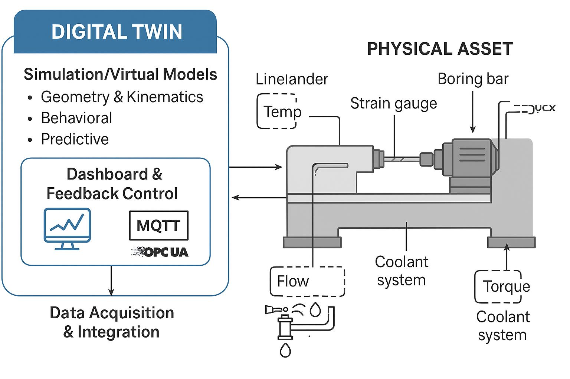
Line Boring Machine - Digital Twin Architecture

